Slide 1
SRA Scorecard
Definition of Terms

Slide 2
Sales Reducing Activities (SRA’s)
SRA’s POS activities that either decrement the gross sales, margin or alter tax rates. Industry experience has proven that SRA rates have a relationship with shrink and company profitability
SRA’s which impact Sales
Item Voids – Removing items from the transaction prior to tendering
Transaction Cancels – Cancelling the entire transaction prior to tendering
Post Voids – Cancelling a transaction after it has completed
Refunds – Taking a product back from a customer and issuing them with a payment
SRA’s which impact Margin
Price Modifies – A manual change in the price of an item in either a sale or a refund
Price Discounts – A manual reduction in the price of an item for a specific reason
Coupons – A reduction in the price of an item or a transaction via a coupon
SRA’s which impact Tax Rates
Tax Modify – Changing the tax rate on a sale or refund transaction prior to tendering
DO NOT DISTRIBUTE – CONFIDENTIAL INFORMATION
2

Slide 3
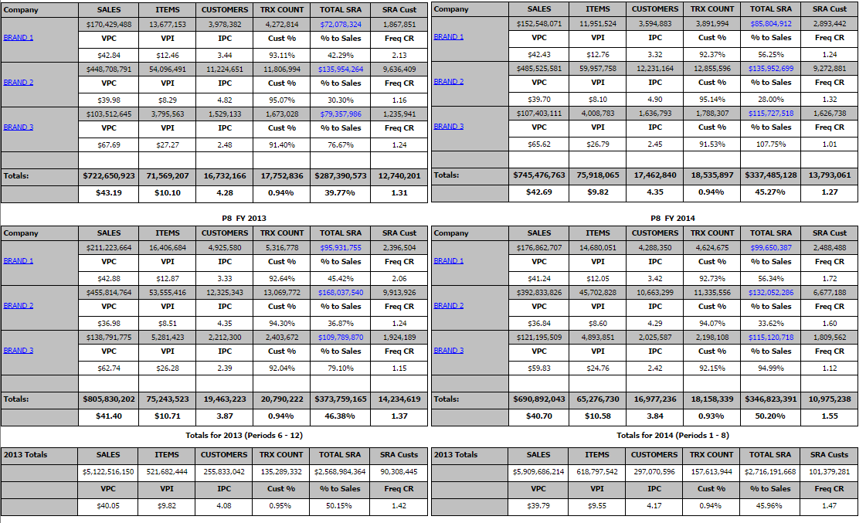
Scorecard Top Level View
Configured according to the location hierarchy this top level view is the entry point to the scorecards.

Slide 4
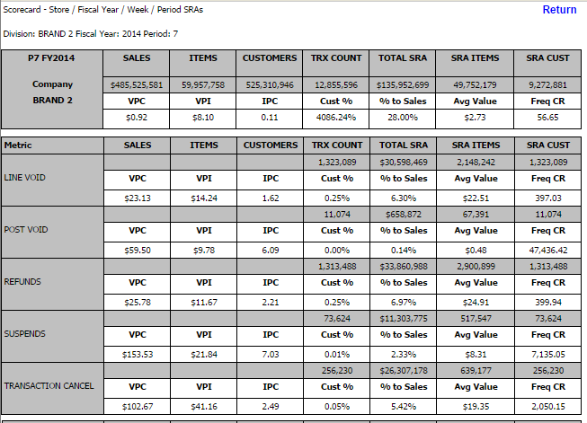
Scorecard SRA Detail

Slide 5
Definition of terms
Sales (net) = gross sales less tax less SRA values (variant)
SCA = sales capture activities
Sales related data – revenue / customers / items
Suspend / recall / scan% / keyed % / transactions / time metrics
SRA = sales reducing activities
8 unique events
Stock Ledger impacting – Voids, Transaction Cancel, Post Void, Refund
Margin impacting – Price Modify, Discounts, Coupons
Tax Modify / Exempt
TES = transaction event sequence
The process/actions to execute a function be it scanning an item, applying a coupon, totaling the order, processing the tender, etc

Slide 6
Definition of terms
EOD = end of day
Report that finalizes sales for the day – creates file(s) that are sent to finance and other designated departments
EOW = end of week
Report that finalizes sales for the week
VPC = value per customer
Sales (net) / customer count
VPI = value per item
Sales (net) / item count
IPC = items per customer
Item count / customer count

Slide 7
Definition of terms
SRA VPC
Value per customer of the SRA event
SRA VPI
Value per item of the SRA event
SRA IPC
SRA Items per customer
PTS = percent to sales
Example Shrink dollars / sales (net)
CR = customer ratio (frequency – tier 1)
Lower number = WORSE
IR – item ratio (frequency – tier 2 optional)

Slide 8
Scorecards
Location Level N
Location Level N SRA
Location Level N SRA Details
Store Year
Store Year SRA
Store Year SRA Details
Store Week Day
Store Week SRA
Store Week SRA Details
Store Day SRA
Secure Question Answers
Store Week Day Details

